Slide 1
Smart Tagging For FAQs

Slide 2
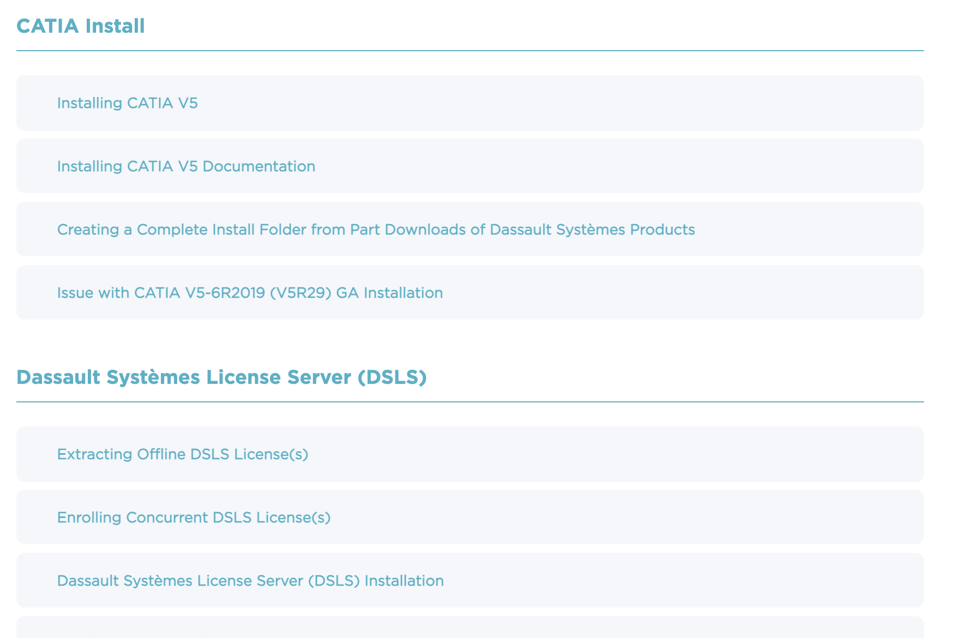

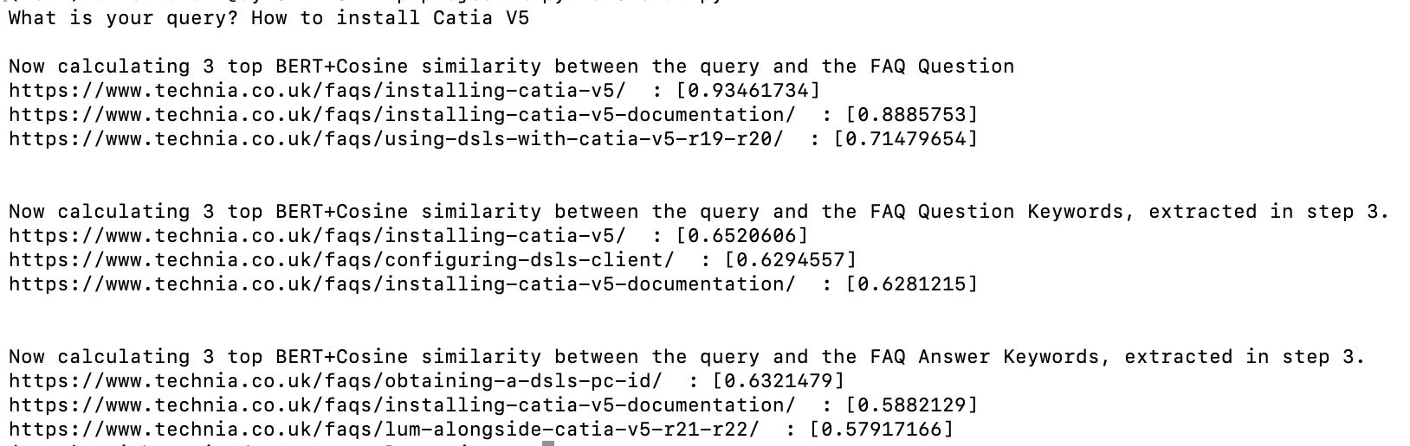
Overview
TECHNIA FAQ Webpage
What does the program do?
When given a query from a user, the program goes through a FAQ webpage and returns the top links that will address that question. I used Python for this program.
The FAQ webpage I based my program around
Answer links in webpage
Code Output
Notes:
I based the scraper program specifically around this specific TECHNIA FAQ webpage. In the code I referred to a html class identifier which was specific to this html webpage. One of the improvements to be made to this solution, is to create a more general web scraper for any help FAQ webpage.

Slide 3
Overview
To create this solution, I had to create 4 main programs:
Web Scraper – Goes through Main FAQ webpage and stores the relevant content of each answer link (heading and body of html page) in text files
Keyword Extractor – Reads the content in each text file and creates a list of key words using a YAKE keyword extraction algorithm
BERT-Cosine Function – Generates a BERT Vector for any two sentences inputted into the function and calculates the cosine similarity between them
Chat Function – Takes in user query and applies Cosine-BERT similarity between:
Query and Full Header content (which would be the heading of the answer link)
Query and keywords in Header content
Query and keywords in Body content
And then returns top three matches for each one
Notes:
Web Scraper- heading and body are stored in separate text files so that we can match keywords in user query to keywords in heading and keywords in body separately. This could potentially allow us to put different weightings on a search result, depending on whether the result comes from a heading match or a body match. It is more likely for a heading match to give the best search result to the user’s query
Bert function only works for short sentences

Slide 4
DEMO
Notes:
cd nlp-project
Source venv/bin/activate
Python3 scraper.py
-show them that you have already ran that program
-show faqQuestionContent folder (stores Header content) and faqAnswerContent folder (stores Body content). The names of the files were generated by hashing the url for each answer link.
-show website and how it matches
-show cross-reference.txt which is used to keep track of which url link corresponds with which hashed text file name
Python3 keywords-extractor.py
-run
-show faqQuestionKeywords folder and faqAnswerKeywords folder
-returns keywords and number next to it shows weighting
Python3 chat.py
-run
-the program compared the user input to three different pieces of content.
-it compared the user input to all the textfiles in the faqQuestionContent folder (AKA the headers in each answer link)
-it also compared user input to files in the faqQuestionKeywords folder and the in the faqAnswerKeywords folder
-for each of the three comparisons, the program would have calculated the cosine similarity between pairs of user input and content of the 33 textfiles.
-It would then find the top 3 textfiles which had the highest cosine similarity with the user input, and using cross-reference.txt, match the hashed filename with its corresponding url to output the top 3 url links

Slide 5
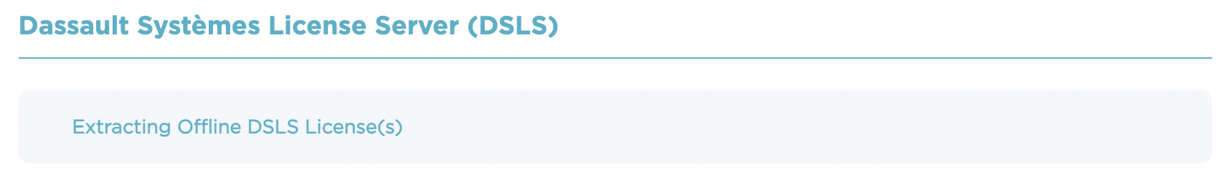
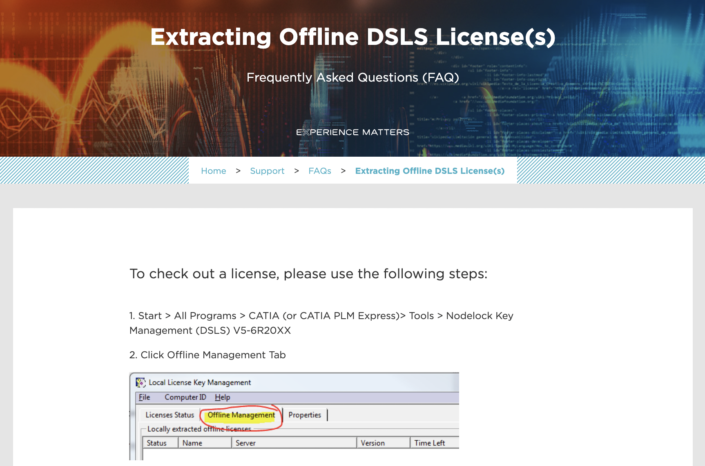
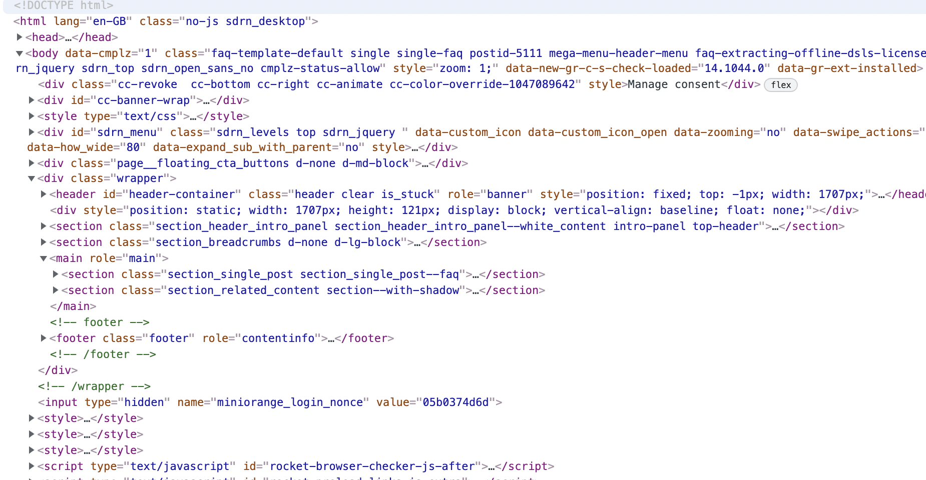
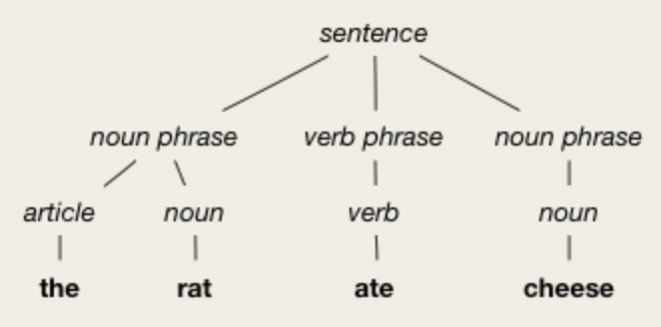
Implementing - Web Scraper
The Web Scraper was used twice; first to scrape the main FAQ page for all headers of the answer pages and their corresponding urls, and then to scrape each of the answer pages for the body content inside the page.
To do the scraping I used Beautiful Soup which is a python library used to pull data out of HTML.
It creates a parse tree from the source code of the webpage. The parse tree can be used to extract data in a hierarchal and more readable manner.
A parse tree is an ordered, rotted tree that represents the syntax structure of a string
Using the methods provided by the library like .prettify(), .SoupStrainer,(), .get_text() I was able to get data from specific html tags (like <a> for links, <p> for paragraph content, etc) and wrote content into the text files
For each answer link in the webpage, I created one text file for the header and another text file for the content in the page (in folders faqQuestionContent and faqAnswerContent respectively). To generate the names of the text files, I hashed the url of the answer link and added a ‘.txt’ at the end.

Slide 6
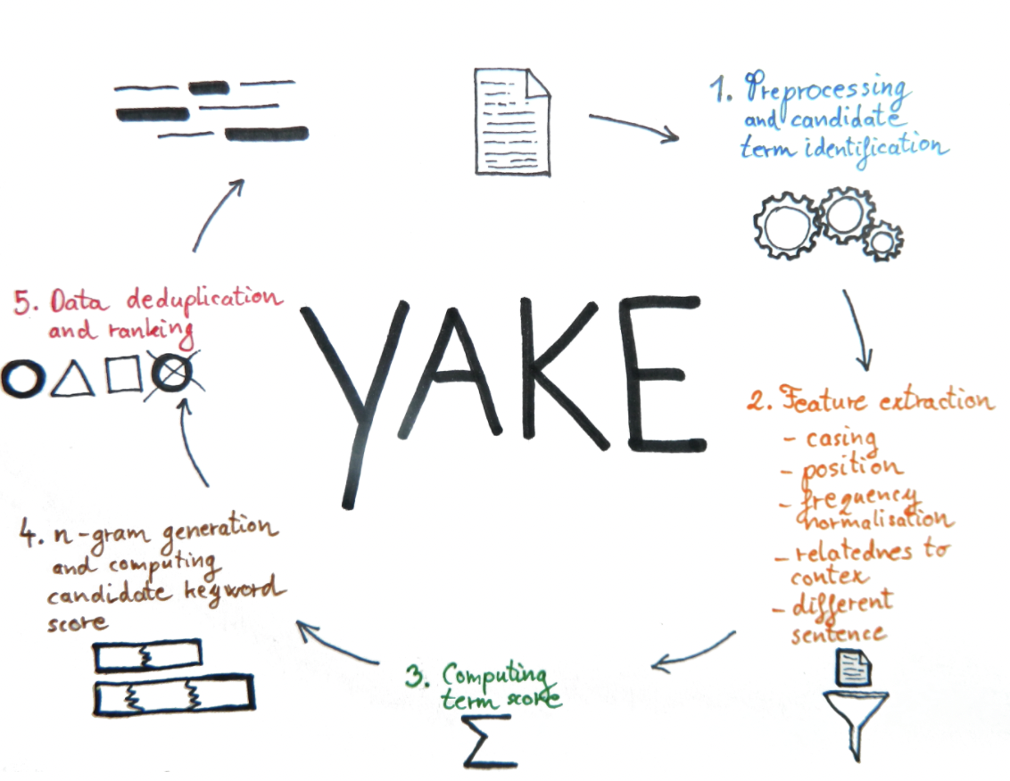
Implementing – Keyword Extractor
To classify each text file I decided to extract the keywords from its contents.
My journey:
Considered Google’s Cloud Natural Language API but learned that it was not useful for highly technical content
Decided to try out other statistical and graph-based Keyword Extraction methods
I tried TF-IDF, YAKE and RAKE before finally settling on YAKE.
Notes:
To classify each text file I decided to extract the keywords from its contents. Initially I thought of using Google’s Cloud Natural Language API. However, I learned that because I was dealing with highly technical content, the API would struggle because it was designed to analyse natural language.
I did more research on keyword extraction methods and decided to test out unsupervised (do not need training) and domain-independent methods. These methods could be split into three groups: statistical, graph-based and embedding based.
I tried two statistical methods called TF-IDF and YAKE and one graphical method called RAKE.

Slide 7
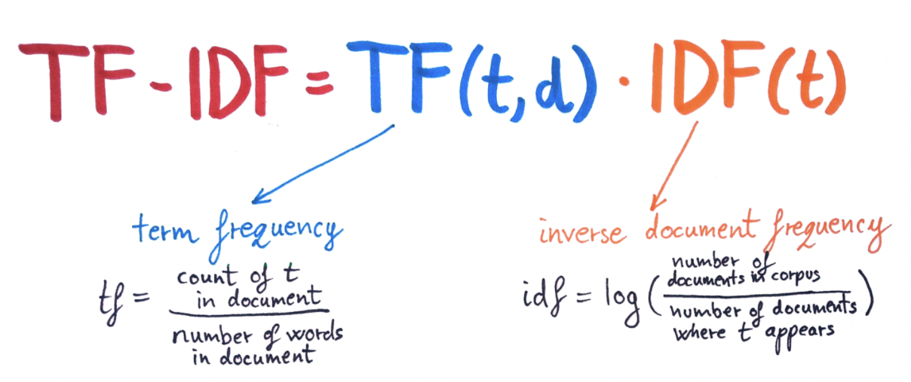
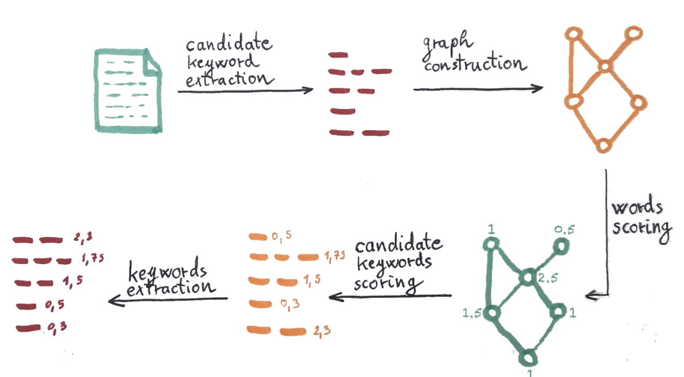
TF-IDF, RAKE
TF-IDF (term frequency–inverse document frequency)
Statistical Method
Fast, Language Independent
Needs a corpus (set of documents) of at least a few dozen documents
RAKE (Rapid Automatic Keyword Extraction)
Graphical method
More complex than statistical methods
Algorithm is performed on each document separately so does not need a corpus of documents to perform keyword extraction
Notes:
TF-IDF (term frequency-inverse document frequency) estimates word importance in the document relative to the entire set of documents. For each term, it find term frequency (number of times t appears/number of words in document) and inverse document frequency (log of (number of documents/number of documents where t appears) and multiples them together.
The term with the highest TF-IDF values are selected as key words. The idea of TF-IDF is that words that appear more frequently in the document are not necessarily the most relevant. This algorithm favours terms that are frequent in the text document and not frequent in the other documents.
The advantage of TF-IDF is that it is fast, and the disadvantage is that it needs a corpus of at least a few dozen documents. TF-IDF is language independent.
RAKE is a graphical method and it is far more complex.
In summary it:
-decides on keyword candidate based on certain criteria
-it then generates a graph. The vertices in the graph are words and they are connected if they appear in the candidate keywords.
-each word in the graph is then scored based on word degree, word frequency, and ratio of degree to frequency. This metric favours words that mainly occur in longer candidate keywords
-the candidate key words are then scored (by summing the score of its member words) and the 1/3 of the best scoring keywords are extracted

Slide 8
YAKE
YAKE (Yet Another Keyword Extractor) is a statistics-based keyword extraction method that has 5 main steps:
Preprocessing and candidate term identification — Text is split into sentences, chunks (part of the sentence separated with punctuations), and tokens. Text is cleaned, tagged and stop words are identified. (Words like the, in, or a. They don’t change the meaning of a text and are only used for structure.)
Feature extraction — The algorithm computes the following five statistical features for terms (words) in the document: a) Casing — counts a number of times (proportional to all appearances) that term appears uppercase or as an acronym in text. A significant term usually appears uppercase more often. b) Term position — median position of the term’s sentence in the text. Terms closer to the beginning used to be more significant. c) Term frequency normalisation —measures balanced term frequency in the document. d) Term relatedness to context — measures with how many different terms the candidate term co-occur. More significant terms co-occur with less different terms. e) Term different sentence — measures how many times terms appear in different sentences. A higher score indicates a more significant term.
Computing term score — Features from the previous step are combined to a single score with a man-made equation.
Generating n-gram and computing keyword scores — The algorithm identifies all valid n-grams (continuous sequence of words in a document). Words in the n-grams must belong to the same chunk and must not start or end with a stopword. Then each n-gram is scored by multiplying its member scores and normalized to reduce the n-gram length’s impact. Stopwords are treated differently to minimize their impact.
Data deduplication and ranking — In the last step algorithm removes similar keywords. It keeps the one that is more relevant (one with a lower score). In the end, the list of keywords is sorted based on their scores.

Slide 9
Implementing – BERT-Cosine Function
This function has two parts:
Using BERT model to to generate sentence vectors
Using cosine similarity functions to give an approximate similarity between the sentence vectors
Explanation
To understand the BERT model, we first need to understand word embeddings then transformers and finally how BERT works
Then we will go through the cosine similarity method

Slide 10
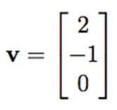
BERT
Word embeddings
A word embedding a learned representation for text where words that have the same meaning (for e.g. words that correspond in a thesaurus) will have a similar representation.
Representational learning is learning representations of input data typically by transforming it or extracting features from it (by some means) that makes it easier to perform a task like classification.
To carry out word embedding, each word in a sentence is mapped to a vector. These vectors are created by using a distributed representation based on the usage of words. This allows words that are used in similar ways to result in having similar representations, and therefore captures their meaning,
Transformers
Earlier to create word vectors you had to train a machine learning model and then use its weights to generate an embedding (so essentially it was very complex and time taking), but sentence transformers can be used to access some of the best pre-trained models to generate word embeddings.
BERT (Bidirectional Encoder Representation from Transformers)
BERT is one of those models. It makes use of an attention mechanism that learns the contextual relations between words in a text and uses that knowledge to generate word embeddings.

Slide 11
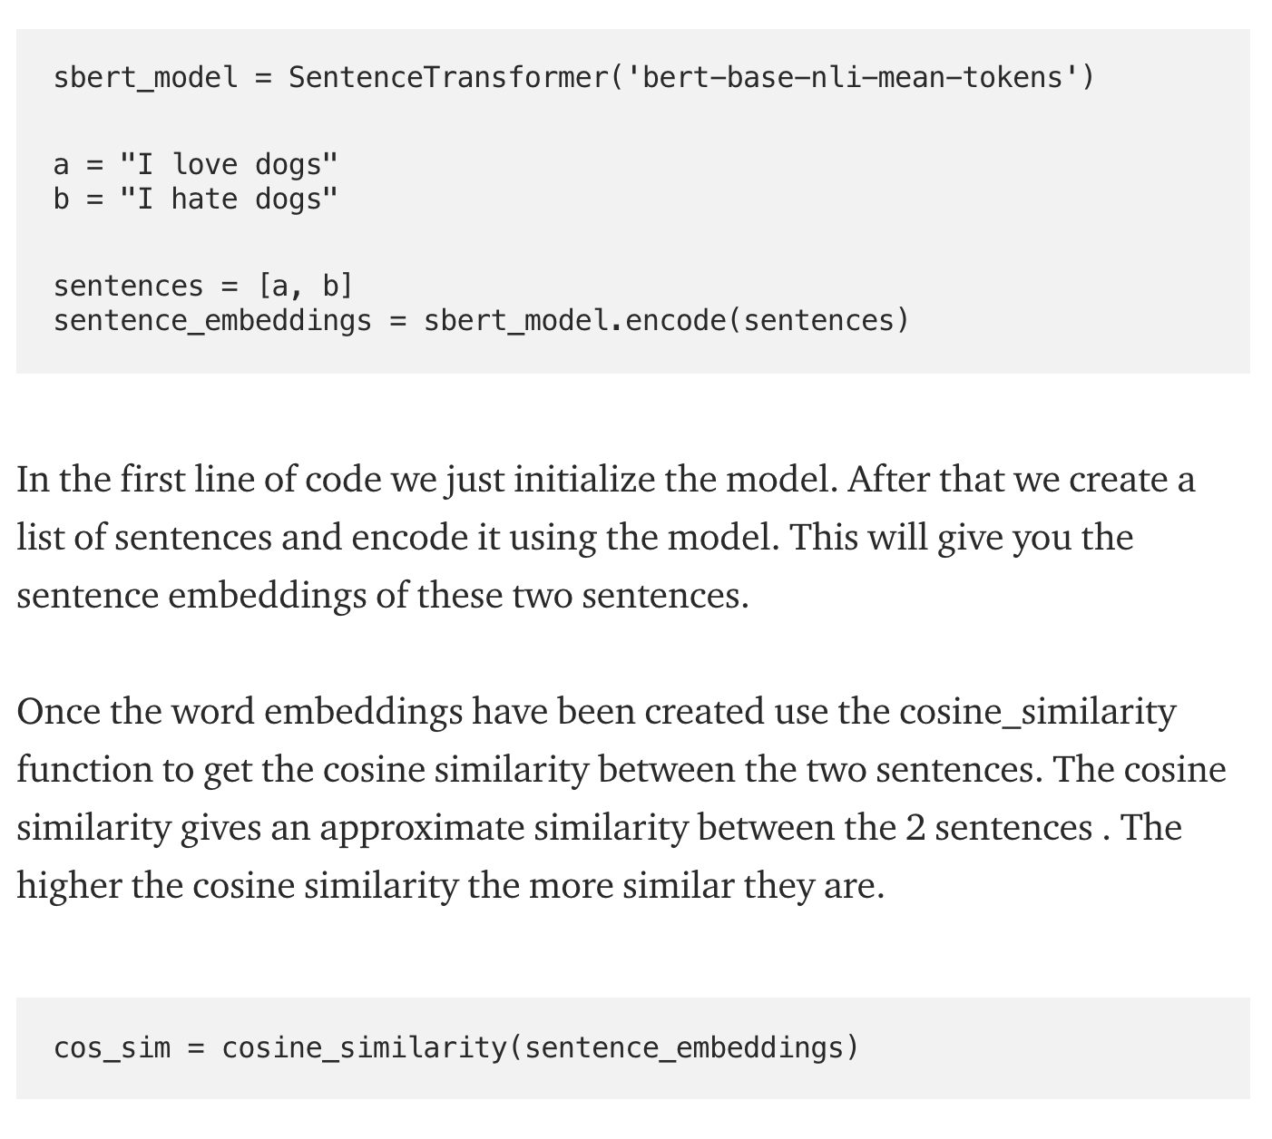
BERT-Cosine
The Code Explained:

Slide 12
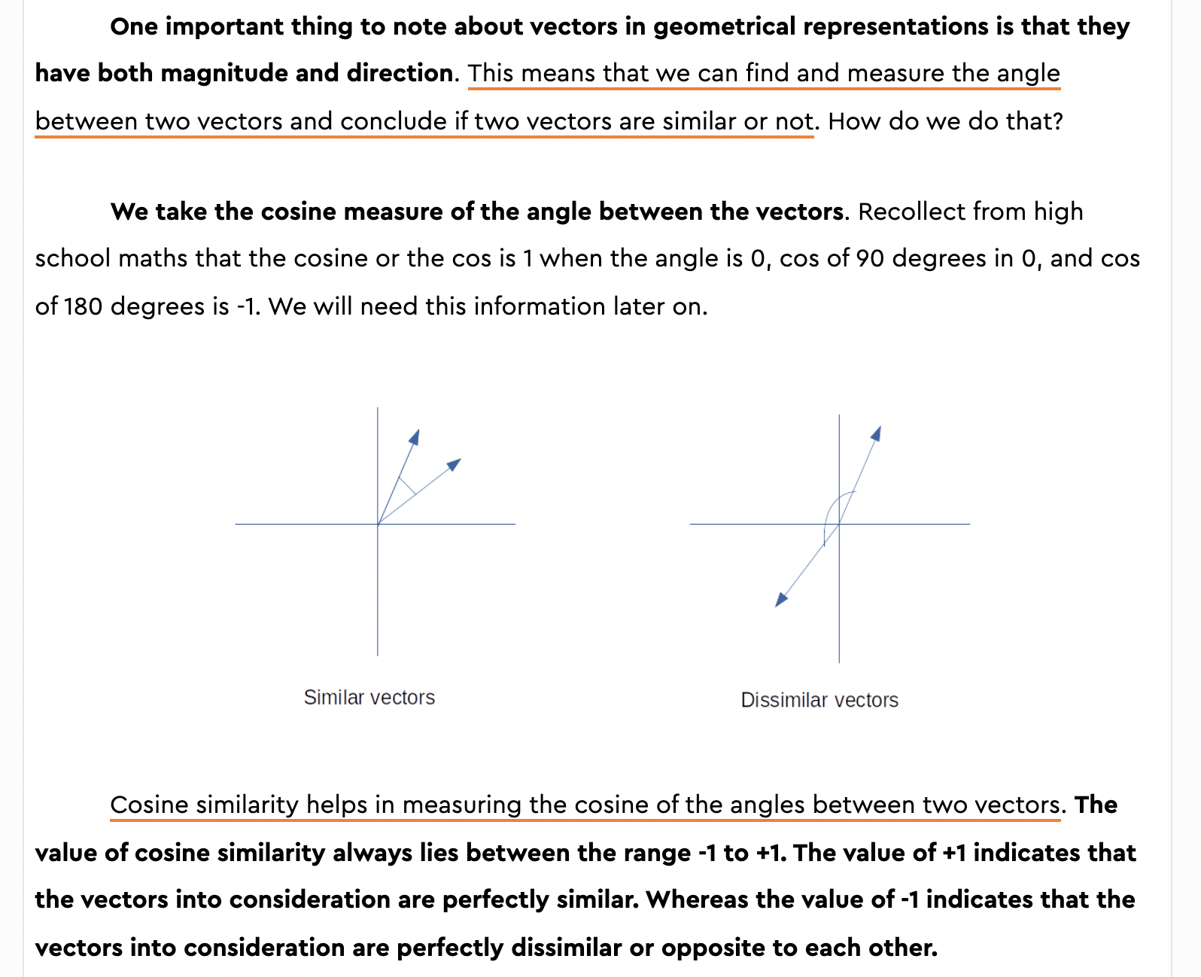
Cosine Similarity
How does the Cosine Similarity work?
Mathematical Context:
All of the math on the right shows that when we check two sentence vectors for how similar they are, if we get a cosine similarity of +1 it means the documents are similar, if we get -1 it means they are not similar
The cosine_similarity() function carries out this process for the sentence vectors that were generated using the BERT method and outputs the similarity value

Slide 13
Next Steps
Notes:
1. Exception handling
2. How to add context to BERT model (eg add/remove domain keywords, manually)
3. Optimise the different variables
a) YAKE parameters
b) BERT model
4. Testing to determine the best method
5. Can we make it quicker

